Slide 1

Insertion Sort
Navin kumar Agrawal
Assistant Professor
Dept. of CEA, GLA University, Mathura

Slide 2
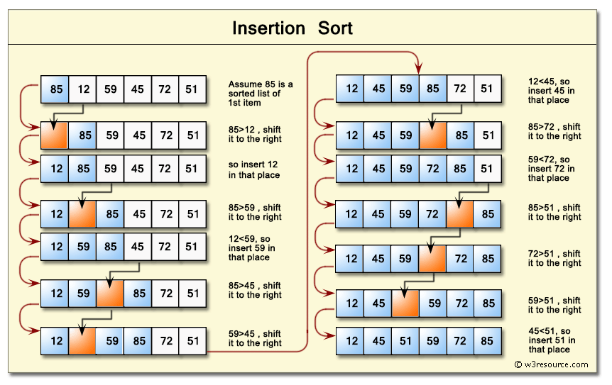
Insertion Sort

Slide 3
Algorithm
void insertion_Sort(arr[], n) //arr is an array, and n is size of array
{
for i=1 to n do {
key = arr[i];
j = i - 1;
while (j >= 0 && arr[j] > key) do
{
arr[j + 1] = arr[j];
j = j - 1;
}
arr[j + 1] = key;
}
}

Slide 4
Algorithm
0 1 2 3 4 5 6 7
4 3 2 10 12 1 5 6
N=8
i=1,2,3,4,5,6,7
Take i=1
Key=a[i]=a[1]=3
J=i-1=1-1=0
Loop : j>=0 and a[j]>key i.e. a[0]>3 4>3 yes
A[j+1]=a[j] a[1]=a[0]
4 4 2 10 12 1 5 6
j=j-1=-1 loop will be false
After loop a[-1+1]=3
3 4 2 10 12 1 5 6
<BCSC0807:Design and Analysis of Algorithms Lab>

Slide 5
Algorithm
0 1 2 3 4 5 6 7
3 4 2 10 12 1 5 6
Take i=2
Key=a[i]=a[2]=2
J=i-1=2-1=1
Loop : j>=0 and a[j]>key i.e. A[1]>2 4>2 yes
A[j+1]=a[j] a[2]=a[1]
3 4 4 10 12 1 5 6
j=j-1=1-1 =0 loop again run
j>=0
and a[j]>key i.e. A[0]>2 3>2 yes
A[j+1]=a[j] a[1]=a[0]
3 3 4 10 12 1 5 6
J=j-1 =0-1=-1 loop will stop
A[j+1]=key
2 3 4 10 12 1 5 6
<BCSC0807:Design and Analysis of Algorithms Lab>

Slide 6
Algorithm
0 1 2 3 4 5 6 7 2 3 4 10 12 1 5 6
Take i=3
Key=a[i]=a[3]=10
J=i-1=3-1=2
j>=0 but a[2]>key 4>10 Loop will not execute
A[3]=key
A[3]=10 No change same
<BCSC0807:Design and Analysis of Algorithms Lab>

Slide 7
Algorithm
0 1 2 3 4 5 6 7 2 3 4 10 12 1 5 6
Take i=4
Key=a[i]=a[4]=12
J=i-1=4-1=3
j>=0 but a[3]>key 12>10 Loop will not execute
A[3]=key
A[4]=12 No change again same
<BCSC0807:Design and Analysis of Algorithms Lab>

Slide 8
Algorithm
0 1 2 3 4 5 6 7
2 3 4 10 12 1 5 6
Take i=5
Key=a[i]=a[5]=1
J=i-1=5-1=4
Loop j>=0 a[j]>key 12>1 Yes
A[j+1]=a[j] a[5]=a[4]
2 3 4 10 12 12 5 6
J=j-1=4-1=3
Loop j>=0 a[j]>key 10>1 Yes
A[4]=a[3]
2 3 4 10 10 12 5 6
<BCSC0807:Design and Analysis of Algorithms Lab>

Slide 9
Python Program
def insertionSort(arr):
for i in range(1, len(arr)):
key = arr[i]
j = i-1
while j >= 0 and key < arr[j] :
arr[j + 1] = arr[j]
j -= 1
arr[j + 1] = key
arr = [12, 11, 13, 5, 6]
insertionSort(arr)
for i in range(len(arr)):
print ("% d" % arr[i])
<BCSC0807:Design and Analysis of Algorithms Lab>

Slide 10
Python Program
def insertionSort(arr):
for i in range(1, len(arr)):
key = arr[i]
j = i-1
while j >= 0 and key < arr[j] :
arr[j + 1] = arr[j]
j -= 1
arr[j + 1] = key
<BCSC0807:Design and Analysis of Algorithms Lab>

Slide 11
Python Program
arr = []
n=int(input('input size of array'))
for i in range(0, n):
ele = int(input())
arr.append(ele)
insertionSort(arr)
for i in range(len(arr)):
print ("% d" % arr[i])
<BCSC0807:Design and Analysis of Algorithms Lab>

Slide 12
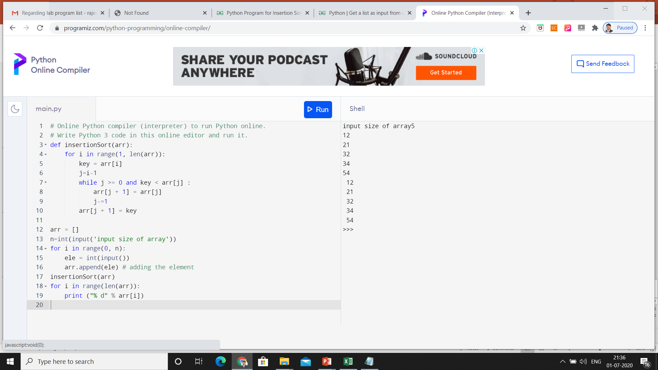
Execution
<BCSC0807:Design and Analysis of Algorithms Lab>

Slide 13
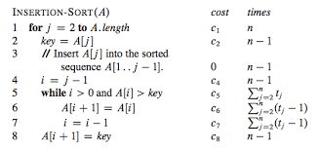
Complexity Analysis
<BCSC0807:Design and Analysis of Algorithms Lab>

Slide 14
Thank You
<BCSC0807:Design and Analysis of Algorithms Lab>

